Slide 1
THE ANDROGENIC DISEASE OF MENOPAUSE
Georges Debled MD

Slide 2
MENOPAUSE
IS NOT A DISEASE
Georges Debled MD

Slide 3
The word “menopause” means “the end of menstruation”.
It is not a disease but a condition.

Slide 4
Many disorders of “menopause” result of a disease :
The Androgenic Disease of Menopause

Slide 5
Every healthy woman secretes every day during her menstrual cycle:
1. Estradiol
2. Progesterone
3. Testosterone

Slide 6
Before menopause every woman secretes every day Estradiol and Progesterone to ensure the Ovule’s nidification

Slide 7
Before menopause every woman secretes every day more Testosterone than Estradiol to ensure the whole Body’s Maintenance of proteins

Slide 8
After menopause the ovaries are no longer secreting
Estradiol and Progesterone are no longer necessary to ensure a pregnancy since there is no egg cell

Slide 9
After menopause the ovaries are no longer secreting
Testosterone to ensure the whole Body’s
Maintenance of proteins

Slide 10
Since there is no more ovule hormonal replacement therapy (HRT) with estradiol and progesterone to ensure a pregnancy is not necessary and can provoke breast cancer.

Slide 11
Since there is no more ovule hormonal replacement therapy (HRT) with estradiol and progesterone to ensure a pregnancy is not necessary and can provoke breast tumor.

Slide 12
HRT is not an anti-aging treatment
The best way to age a woman is to prescribe her an HRT

Slide 13
After menopause the secretion of Testosterone by the ovaries decreases significantly causing a lack of Dihydrotestosterone’s production and the Androgenic Disease of Menopause

Slide 14
Definition of the
Androgenic Disease of Menopause
The Androgenic Disease of Menopause is the whole of physiopathological and psychopathological modifications caused by the acute or progressive reduction of androgens’ production after the definitive cessation of menstruation

Slide 15
The defect of androgens’ production causes
functional consequences
Puffs of heat, irritability, intestinal distension, swelling feet
general consequences
lipids’disorders hypercoagulation vascular disorders venous thromboses | tiredness rheumatic disorders brain’s involution Alzheimer's disease
local consequences
incontinence, urgencies, recurrent cystitis caused by the sclerosis and inflammation of the bladder neck painful or dificult sexual relationships caused by vulva’s sclerosis
www.georgesdebled.org

Slide 16
Functional consequences caused by a defect of male hormones’ production
Puffs of heat, irritability, intestinal distension, swelling of the feet
Result from
weakness of all musculatures (smooth fibers) of arteries, veins and intestine
The small intestine is 6.5 meters long and the large intestine 1.5 meters

Slide 17
Local consequences
incontinence, urgencies, recurrent cystitis caused by the sclerosis and inflammation of the bladder neck painful or dificult sexual relationships caused by vulva’s sclerosis
Are the consequences of a
defect of
dihydrotestosterone’s production

Slide 18
Definition of the
Androgenic Disease of Menopause
The menopause disease is the whole of the physiopathological and psychopathological modifications caused by the acute or progressive reduction of androgens’ production after the definitive cessation of menstruation

Slide 19
The Treatment of the
Androgenic Disease of Menopause consists in replacing male hormones with Mesterolone

Slide 20
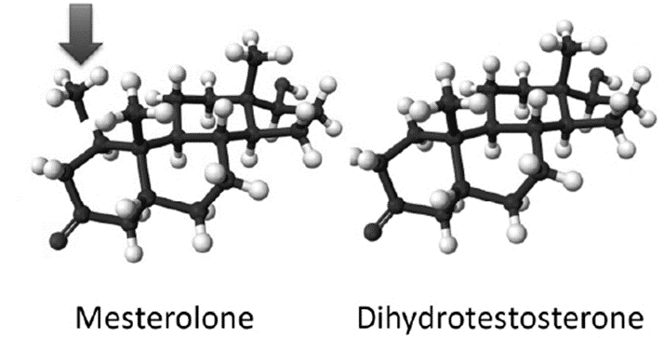
Mesterolone has the Properties of Testosterone and Dihydrotestosterone
For technical reasons Testosterone ( pills, pellets,injections) use is contraindicated
Mesterolone transformes in a natural hormone : Dihydrotestosterone
1.DEBLED G. Mesterolone pharmaceutical composition for dihydrotestosterone deficiencies in the woman. EPO. Application No Patent No 121/6851.9 - 1466/268/215 European Patent Bulletin 18/48 of 28.11.18.
2. DEBLED G. Steroid hormone for the prevention of diseases associated with aging. OPRI (Office belge de la propriété intellectuelle): 100072468. Nº 2019/5905. 13 décembre 2019.
3.DEBLED G. Curso: La enfermedad androgénica de la andropausia y de la menopausia. SEMAL. III Congreso Intercontinental de Medicina Antienvejecimiento. Hotel Hilton. Panamá 17 de marzo 2022. (semal.org)

Slide 21
For more details: hmsworld.net/ageless-woman.htm

